Slide 1

Real Estate Price Prediction with Machine Learning
GABRIELA GRANDA
JANHAVI BHARATI
SANTIAGO CORTES
MIGUEL GOMEZ
THET WIN

Slide 2
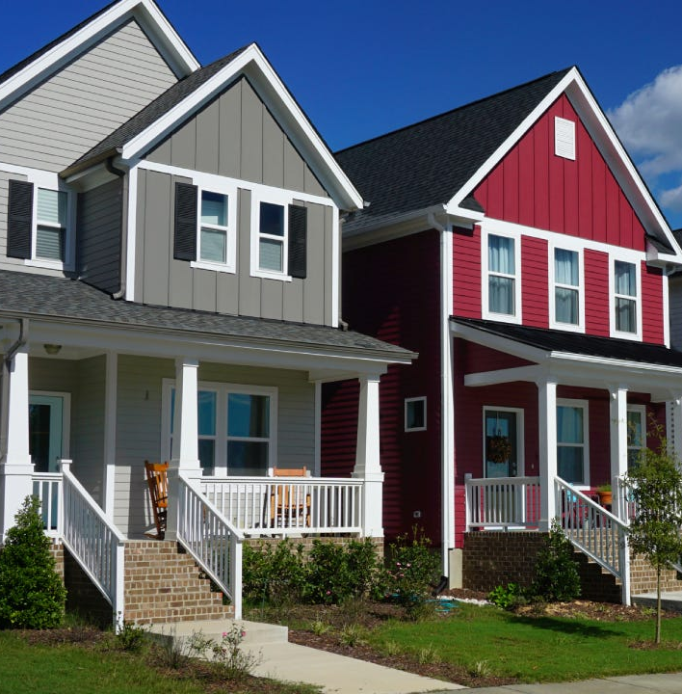
AGENDA
Introduction
Median sales price of single-family homes in the United States
Business Requirements
Current Status Evaluation
Key Questions
Data Analytics & Visualization
Defining Source Data
Median Size of The House
Cost of House Sold Trend
Building The Model
Visualization Using Tableau
Conclusion & Insights
Summary
Future Improvements

Slide 3
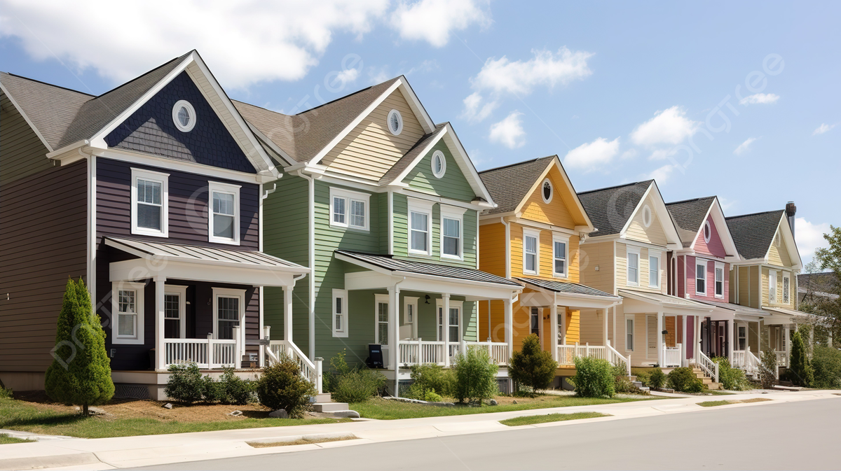
Introduction

Slide 4

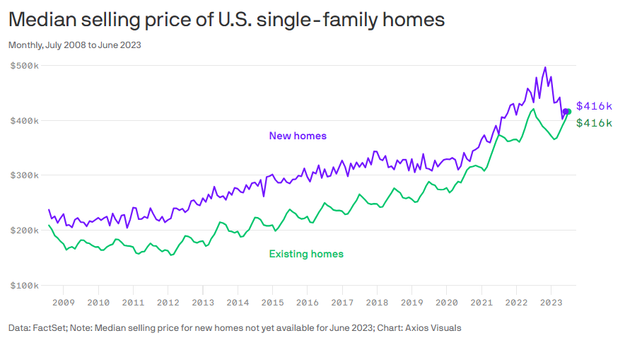
Median sales price of existing single-family homes in the United States from 2000 to 2023
Data shows the median price for an existing single-family home — as opposed to a newly built one — stood at $416,000 in June 2023.

Slide 5

Business Requirements

Slide 6

BUSINESS REQUIREMENTS
Current Status Evaluation
In the competitive real estate market, predicting property prices accurately can provide critical insights for buyers, sellers, and investors.
In this project, we aim to build a machine learning model that predicts real estate prices based on various property features. The questions we will address today are: How accurately can we predict housing prices, and what are the most important factors influencing these prices?
Key Questions
"Can we predict property prices accurately using machine learning?"
"What are the key factors that influence housing prices?"

Slide 7

Data Analytics & Visualization

Slide 8
Defining SOURCE data
Our dataset consists of over 1,000,000 real estate listings from across the U.S. broken down by State and Zip Code. But for this project, we focused on Illinois. We processed the data by handling missing values, categorically encoding non-numerical features, and scaling numerical ones. Features like house size and land area were essential for the model.
Target Variable
price (Housing price, it is either the current listing price or recently sold price if the house is sold recently)
Feature Variables
brokered by (categorically encoded agency/broker)
status (Housing status - a. ready for sale or b. ready to build)
bed (# of beds)
bath (# of bathrooms)
acre_lot (Property / Land size in acres)
street (categorically encoded street address)
city (city name)
state (state name)
zip_code (postal code of the area)
house_size (house area/size/living space in square feet)
prev_sold_date (Previously sold date)
Preprocessing steps included handling missing values, categorical encoding, and scaling numerical features.

Slide 9
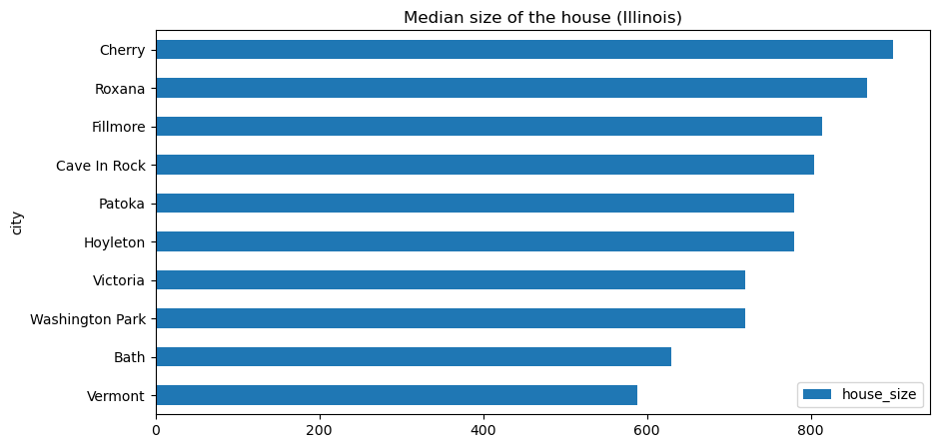
House Median Size
Cherry City, Roxana and Fillmore are the top 3 cities with largest homes being sold.
Notes:
Economic changes could have led consumers to reduce their spending, thereby decreasing the volume of credit card transactions.
There might be a shift towards alternative payment methods such as digital wallets or cryptocurrencies, impacting credit card usage.
During the COVID-19 pandemic, consumers were more inclined to use credit cards for transactions. However, as the situation normalized in 2023, there may have been a resurgence in in-person cash transactions.
These hypotheses, while plausible, are speculative due to the constraints of the dataset. Further investigation is recommended to confirm these assumptions and develop strategies to address the decline in credit card transactions.

Slide 10
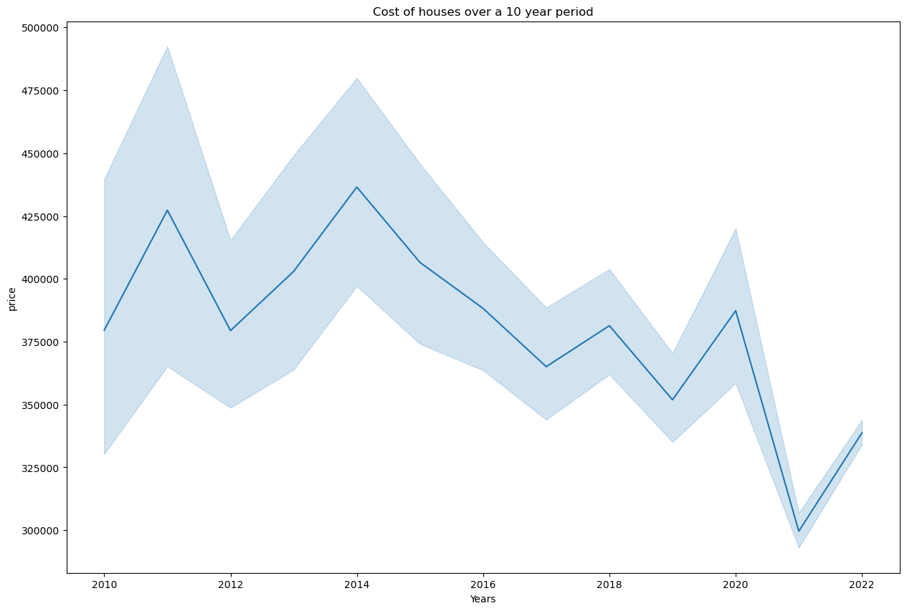
Cost of House Sold Over 10 Years Period in Illinois
The home prices declined drastically from 2010 to 2021. The prices began to recover slightly in 2022.
Notes:
Economic changes could have led consumers to reduce their spending, thereby decreasing the volume of credit card transactions.
There might be a shift towards alternative payment methods such as digital wallets or cryptocurrencies, impacting credit card usage.
During the COVID-19 pandemic, consumers were more inclined to use credit cards for transactions. However, as the situation normalized in 2023, there may have been a resurgence in in-person cash transactions.
These hypotheses, while plausible, are speculative due to the constraints of the dataset. Further investigation is recommended to confirm these assumptions and develop strategies to address the decline in credit card transactions.

Slide 11
BUILDING The Model
Model Type
We trained a deep learning model using a neural network to predict property prices. We split the dataset into training and testing sets to evaluate model performance.
Preprocessing Steps:
We performed categorical encoding, feature scaling, and handled missing values before feeding the data into the model.
Model Performance:
Accuracy: 77%

Slide 12

Using the tool for live predicting

Slide 13
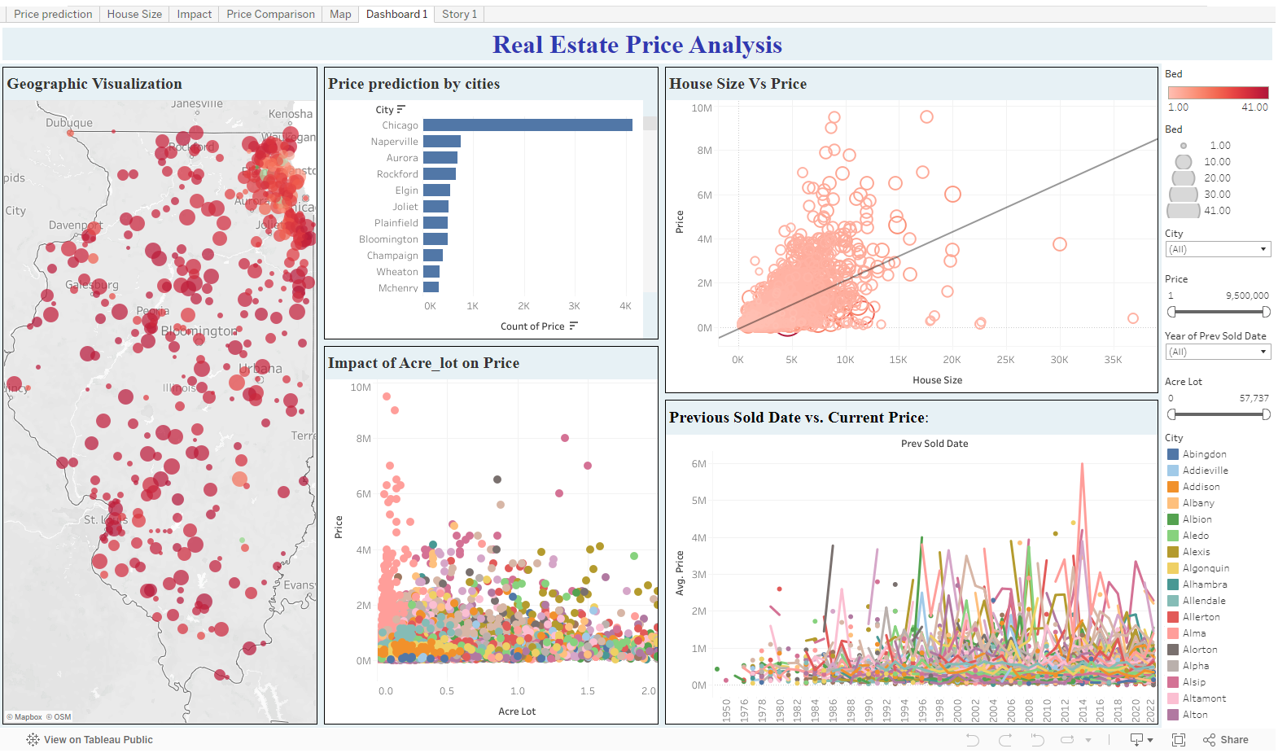
VISUALIZATION USING TABLEAU
https://public.tableau.com/app/profile/janhavi.bharati/viz/Project4_17290938313380/Dashboard1
Notes:
Economic changes could have led consumers to reduce their spending, thereby decreasing the volume of credit card transactions.
There might be a shift towards alternative payment methods such as digital wallets or cryptocurrencies, impacting credit card usage.
During the COVID-19 pandemic, consumers were more inclined to use credit cards for transactions. However, as the situation normalized in 2023, there may have been a resurgence in in-person cash transactions.
These hypotheses, while plausible, are speculative due to the constraints of the dataset. Further investigation is recommended to confirm these assumptions and develop strategies to address the decline in credit card transactions.

Slide 14

Conclusion & INSIGHTS

Slide 15

SUMMARY
The model performed with 77% accuracy in predicting housing prices in Illinois.
Key influencing factors included house size, lot size, and the number of bedrooms.
Its important to mention that the model good for predicting house prices based on features in the present, but it does not perform well for predicting future prices unless we include time-based and economic indicators
The current model is built to predict prices based on historical data. It relies on the relationships between features like house size, number of rooms, and location, and the target price in the data we provided.
Future Improvements:
Incorporating more advanced techniques and additional data could help improve the model's performance

Slide 16

THANK YOU ANY QUESTIONS?
GABRIELA GRANDA
JANHAVI BHARATI
SANTIAGO CORTES
MIGUEL GOMEZ
THET WIN

